Slide 1
Agency Prepayment: Turnover
April 2016

Slide 2
Model Update Overview 1. Data Set
1
Base Turnover – at least 30 bps OTM
In order to get turnover from total prepayment, we need to subtract Refinances, Defaults and Curtailments.
Firstly, we use at least 30 bps OTM, which do not have incentive to refinance. Then subtract defaults and curtailments to build our base turnover.
Also, the OTM data includes some OTM cash out refinances. We need to subtract that part from our base turnover.
2
Pool Level Data Set
Consistent with curtailment and default modules, we use pool level information to fit and track turnover module.
3
Refinance Incentive
Incentive acts as the lock-in factor in turnover model. In order to get a more accurate lock-in measurement, we did the following improvements for the pool level incentive:
Modified origination PMI for HARPed loans (CQ/CR/MHA)
Used loan level aggregate incentive instead of calculate directly on pool level

Slide 3
Model Update Overview 2. Model Structure
Turnover model V1
30-80 bp OTM
Data set
Base Turnover
2
Step Fitting
Using two data sets for different incentive ranges
Fit curves:
WALA
HPA2Yr
5
Parameters
At least 30 bp OTM
Data set
Seasonal Adj.
Seasonal Adjustment
WALA
HPA2Yr
Lock-In
CLTV
Fit curves:
Lock-in
CLTV
1
Adjustment Functions
Due to the large data amount for loan level model, two steps fitting will save time. But it’s not necessary for pool level model.
Tweaks for HPA2Yr

Slide 4
Model Update Overview 2. Model Structure
Turnover model V1
Updates
2
1. Subtract OTM cash-out refinance
Step Fitting
The OTM prepayment data includes a partial of cash-out refinance. We need to remove that from our base turnover value.
Using two data sets for different incentive ranges
2. Keep 5 parameters as base structure
In v2, we kept the 5 parameters use in v1. But one thing need to mention is the Lock-in factor is aggregated from loan level.
5
Parameters
3. Remove 2 steps fitting process
Seasonal Adjustment
WALA
HPA2Yr
Lock-In
CLTV
Use all the pool level data at least 30 bps OTM to do the fitting process as one.
4. Remove adjustment functions
The old model involved tweaks because we used loan level data to calibrate the model and then used these adjustment factors to fit pool level data
1
5. Add constraints for extrapolation
Adjustment Functions
Using cap and floors for out of range extrapolation. Make sure the tail performance is reasonable.
Tweaks for HPA2Yr

Slide 5
Model Update Overview 2. Streamline Model Parameters
Turnover model v1
Turnover model v2
2
1
Step Fitting
Step Fitting
Using two data sets for different incentive ranges
Use at least 30 bps OTM data to do fitting
5
5
Parameters
Parameters
Seasonal Adjustment
WALA
HPA2Yr
Lock-In
CLTV
Seasonal Adjustment
WALA
HPA2Yr
Lock-In
CLTV
1
1
Adjustment Functions
Constraint
Tweaks for HPA2Yr
Constraints for extrapolation

Slide 6
Data Preparation 1. Incentive – PMI for HARPed loans
Q
uestion
Our current calculation for HARPed loan incentive is misleading since HARPed loans pay no MI or carry over their MI from the previous loan.
So, what MI the HARPed borrower was paying before they refinanced?
P
roblem
We don’t have information for their previous loans. Hence, we couldn’t use the mapping method and find out their PMI at origination.
S
olution
Using our Enhanced HARPed Identification algorithm, we can identify a HARP% for each loan.
We could use the coverage level to look up MI rates from MGIC documents from before 2009/06 for all the potential HARPed loans.

Slide 7
Data Preparation 1. Incentive – PMI for HARPed loans
Y: HARPed
HARP% = 100
LTV > 80%
MI Test
Using Algo I
Recently Originated Refi Loans
N: Non-HARPed
HARP% = 0
HARP % for each loan
LTV <= 80%
Logistic Regression Model*
Likelihood that loan has been HARPed
Using the Enhanced Algorithm
Pre-HARP
HARPed
Non-HARPed
Non-Eligible: Purchas, refi-CO
Based on our Enhanced HARPed loan identification algorithm, there are around 15 to 30% loans are HARPed. And our previous incentive calculation for those loans might bring problemsto our model.

Slide 8
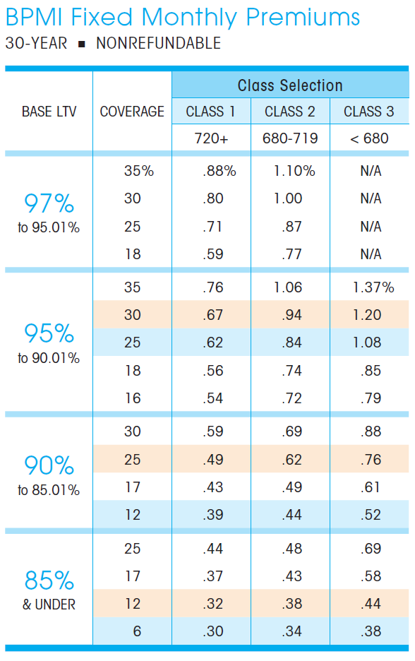

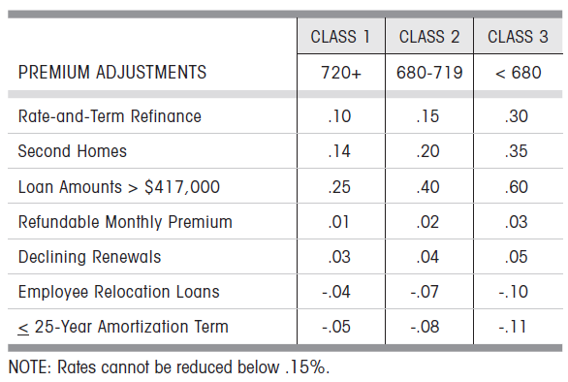
Previous MI Calculation
Example Loan:
Loan Seq Num: U60490000208
Find the MI premium based on loan info
firstPaymtDt | 4/1/2011
cs | 781
origLTV | 121
loanPurposeType | RE-FI-NCO
occType | OWNER
originalLoanAmount | 89,320
pctMtgIns | 20
As the LTV is greater than the largest number in the table, we assigned the max number (or a number of 1000 bps) in the table to the base MI (i.e., we ignore what the credit score is).
We will have a PMI of 110 bps for the loan.

Slide 9
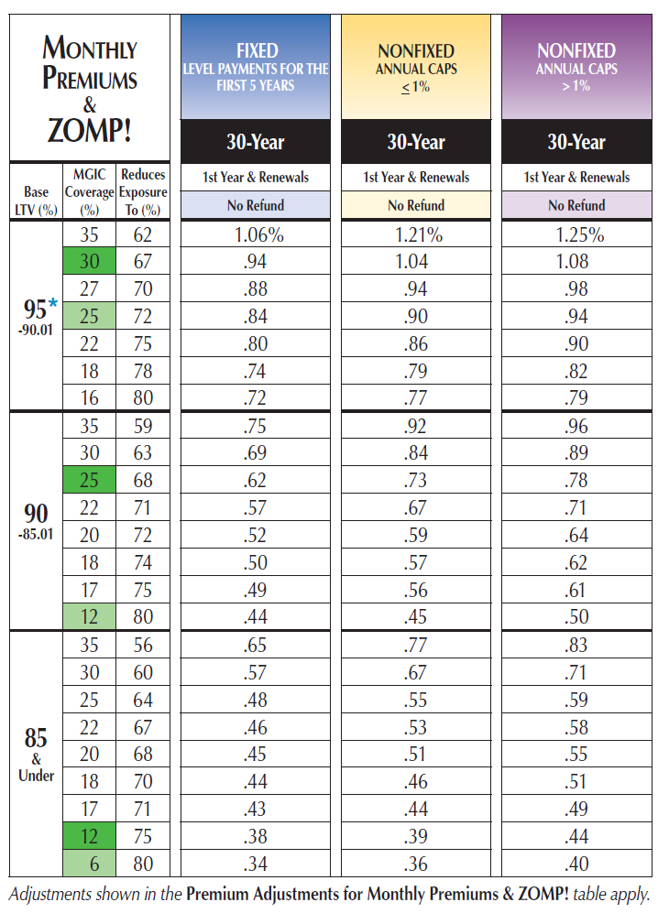

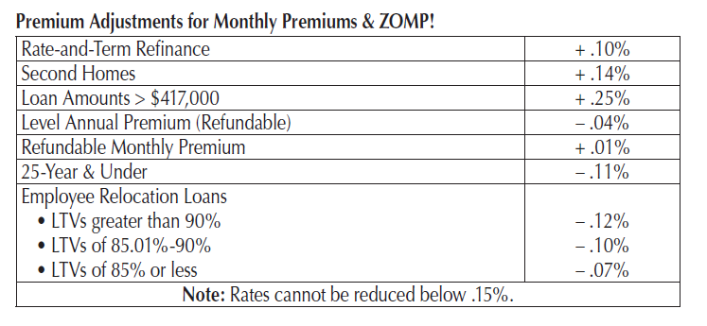
Updated MI Calculation
Example Loan:
Loan Seq Num: U60490000208
Look up the MI coverage
firstPaymtDt | 4/1/2011
cs | 781
origLTV | 121
loanPurposeType | RE-FI-NCO
occType | OWNER
originalLoanAmount | 89,320
pctMtgIns | 20
Based on the historical MI documents, we assign 79 bps MI to the example loan instead of 110 bps.
Makes the incentive 31 bps lower.

Slide 10
Data Preparation 2. Incentive – Loan level aggregation
Q
uestion
Our current calculation for pool level incentive is to treat a pool as a loan then use its weight average of CLTV/FICO and other distribution numbers to map the PMI and LLPA level.
Will the method work well?
P
roblem
We see a dispersion between loan level and pool level.
As the LLPA and PMI mapping is not a linear function, instead, it is step function. So when the pool level WA near the thresholds of each step, it will cause some problems.
S
olution
Use loan level incentive calculation, including LLPA and PMI, as well as special handling of HARPed loan MI
Aggregate the loan level incentive as pool incentive.

Slide 11
Data Preparation 2. Incentive – Loan level aggregation
Loan / Pool Dispersion
For an example pool, we find a typical dispersion caused by the step function, although the pool level weighted average CLTV and FICO are very close to the loan level.

Slide 12
Data Preparation 2. Incentive – Loan level aggregation
Loan level aggregation V.S. Pool level (Effect includes fixing HARPed Origination PMI)

Slide 13
Data Preparation 2. Incentive – Loan level aggregation
Combined Version for Conventional Pools
To handle the problem that there is no loan level data before 2006, we use the pool level before 2006.
The combine version is reliable because the LLPA/PMI impact at that period is minor.

Slide 14
Data Preparation 3. OTM Cash-out Refi
Q
uestion
As we use -30 bps incentive pool prepayments minus defaults and curtailments to get our turnover baseline, there could be some OTM cash-out refi involved in the result.
We need to find a way to remove OTM cash-out refi from the turnover baseline.
P
roblem
There is no clear way to find out the actual OTM cash-out refi volumn.
S
olution
Based on analysis of the “Existing Home Sales Turnover” and the “MBS Universe Turnover”, we can identify the gap around 2% to 4% CPR of our turnover baseline.
Use a simple model to capture the gap, which is potentially the OTM cash-out refi activities.

Slide 15
Data Preparation 3. OTM Cash-out Refi
Turnover EHS
= Existing Home Sales / Owner-occupied housing Stock
Turnover across all home owners, with or without mortgage (all types of mortgages)
Turnover MBS
Prepayments on all pools at least 30 bps OTM after subtracting defaults and curtailments
There is roughly 4% difference consistently between those two curves.
When the difference of two curves get narrower, there is a potential OTM Cash-out refinance wave.

Slide 16
Data Preparation 3. OTM Cash-out Refi
Model to Estimate OTM Cash-out Refi
We introduced a four-factor model to estimate OTM Cash-out Refi
OTM Cash-out Refi = Incentive * HAP2yr * CLTV *WALA
The cash-out refi is capped at 4 CRP

Slide 17
Data Preparation 3. OTM Cash-out Refi
Model to Estimate OTM Cash-out Refi
We introduced a four-factor model to estimate OTM Cash-out Refi
OTM Cash-out Refi = Incentive * HAP2yr * CLTV *WALA
The cash-out refi is capped at 4 CRP

Slide 18
v2 Turnover Model Details 1. Model Multipliers
01
Turnover shows a clear seasonal difference. Remove the difference using seasonal adjustment will help to find the spline functions for the model.
v2 of the turnover model includes the five prediction parameters listed on the left-hand side.
Sequentially fitting model with the five parameters, we can create a cubic spline curve for each one of these inputs.
The parameter ordering is based on a single parameter regression calculated R-square value.
Parameters that have earlier order will have more significant impact on our model out put.
Seasonal Adj.
02
The WALA ramp effect shows a increasing trend of turnover as loan age goes up.
WALA
03
When HPA goes higher, borrowers will have a higher chance to sell their house.
HPA2Yr
04
When the incentive is too low, the home owners are less willing to move as the rate cost for their current house is too low.
Lock-in
05
Borrower with higher CLTVs are more difficult to move.
CLTV

Slide 19
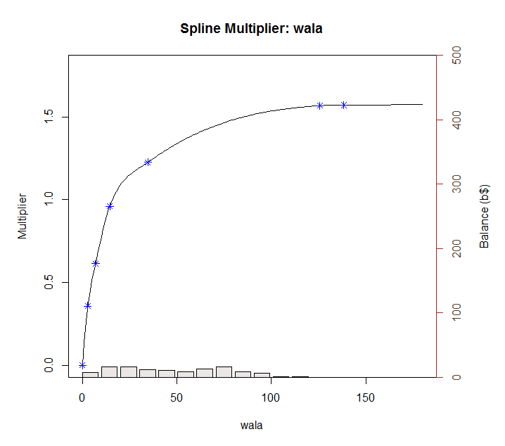
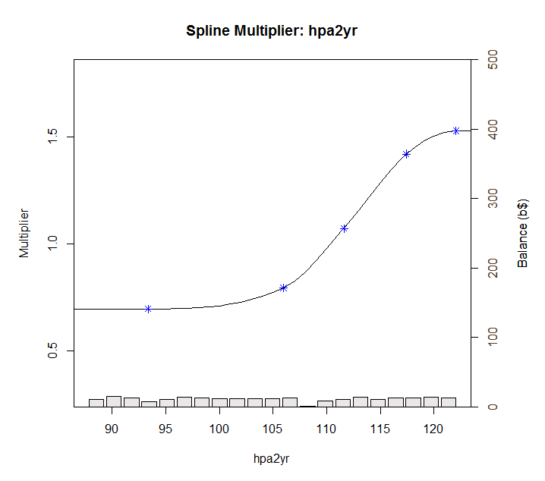
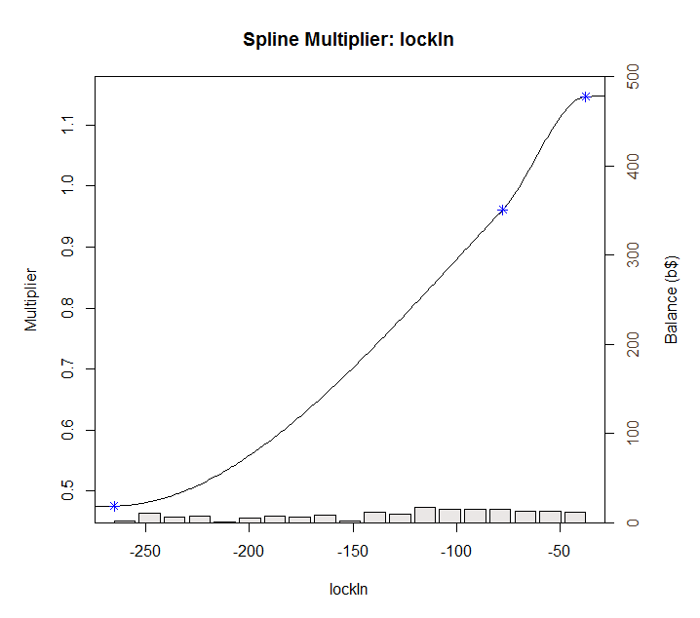
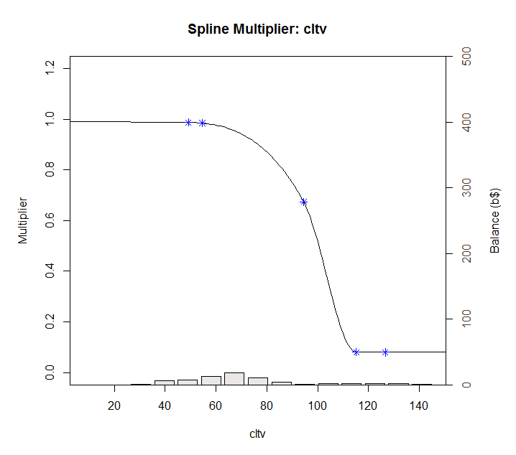
v2 Turnover Model Details 2. Model Multiplier Splines

Slide 20
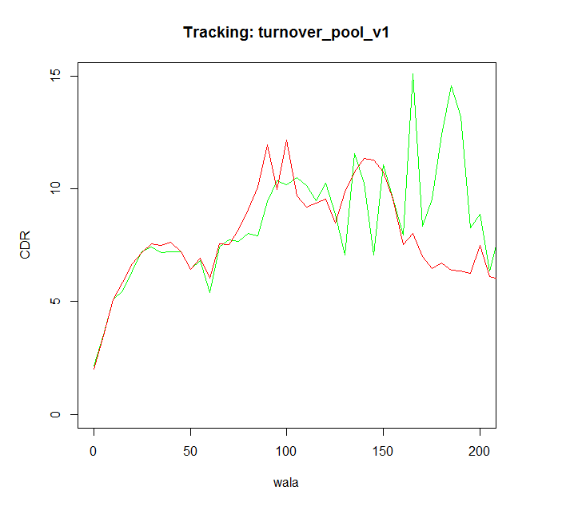
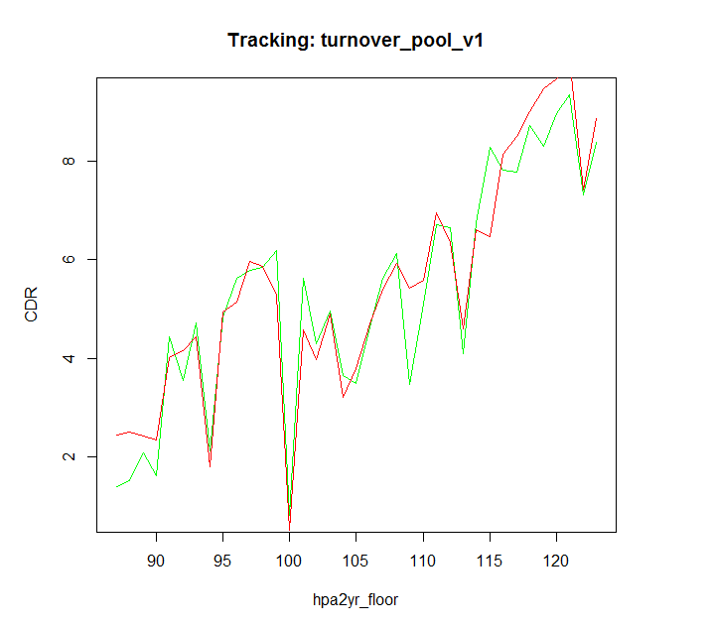
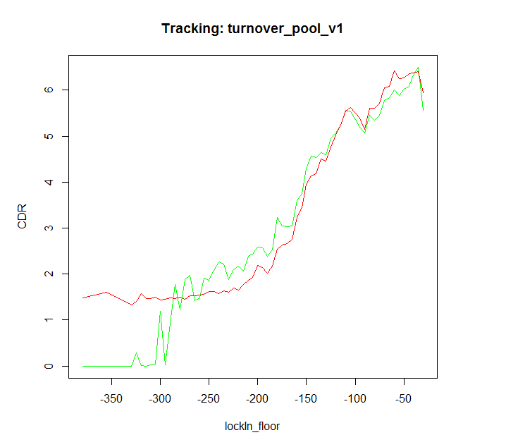
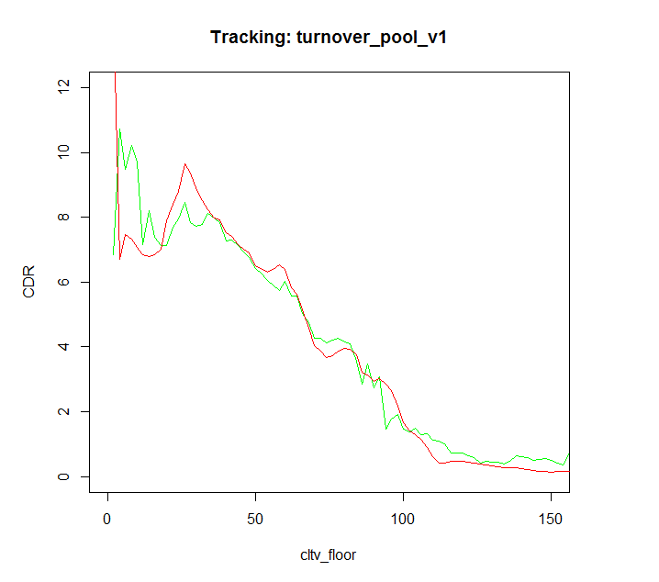
v2 Turnover Model Details 3. Model Multiplier Tracking
Actual
Model

Slide 21
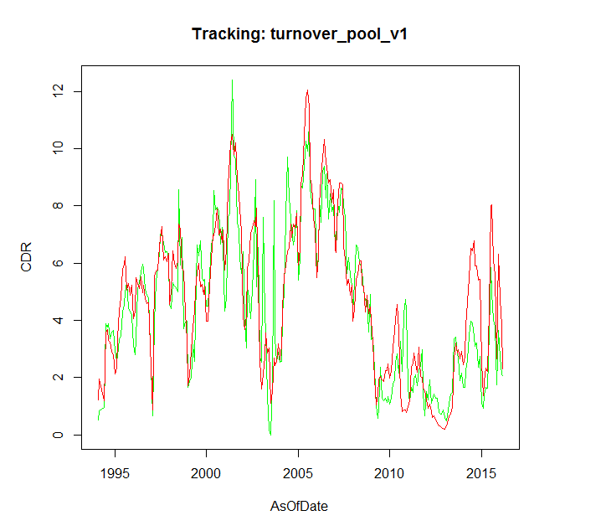
Tracking Performance 1. Overall
Model Tracking Performance – Overall (Conventional + Jumbo + CQ/CR)
Actual
Model

Slide 22
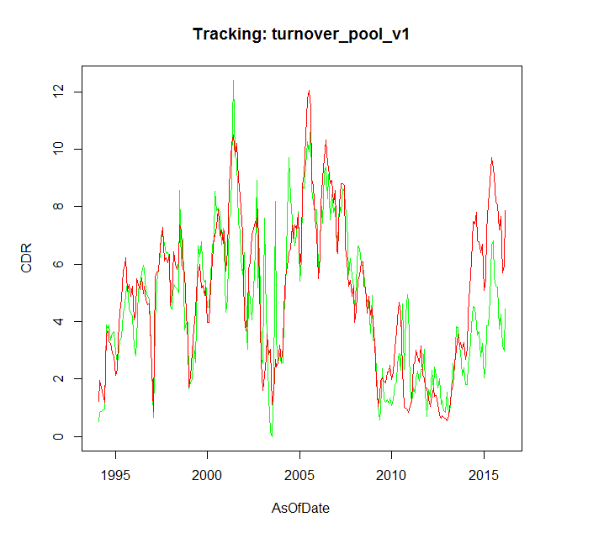
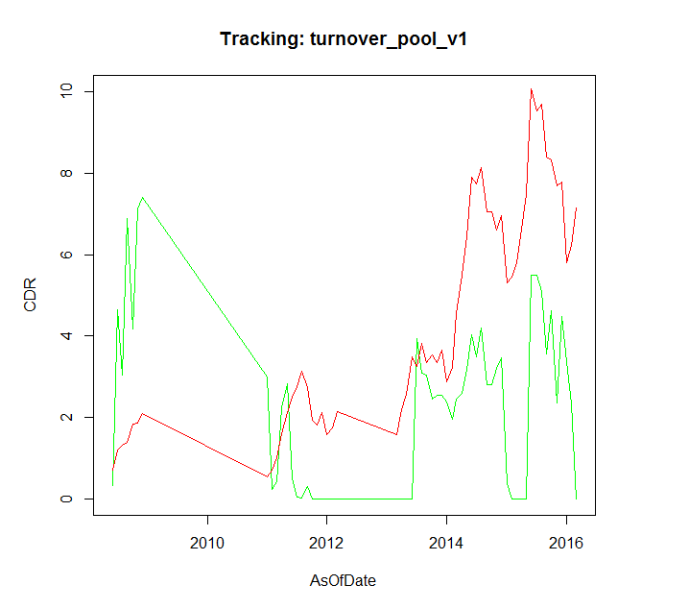
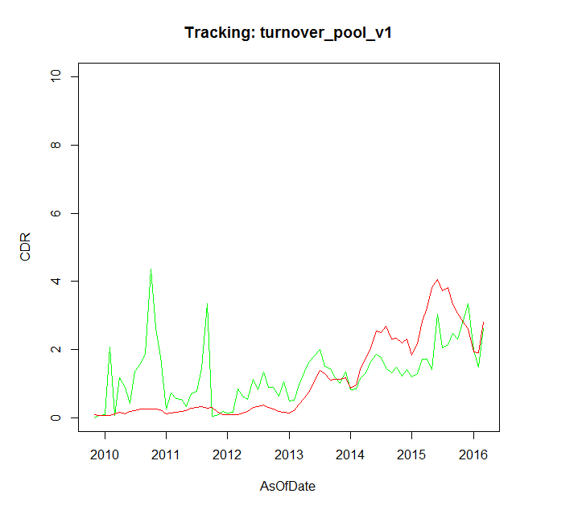
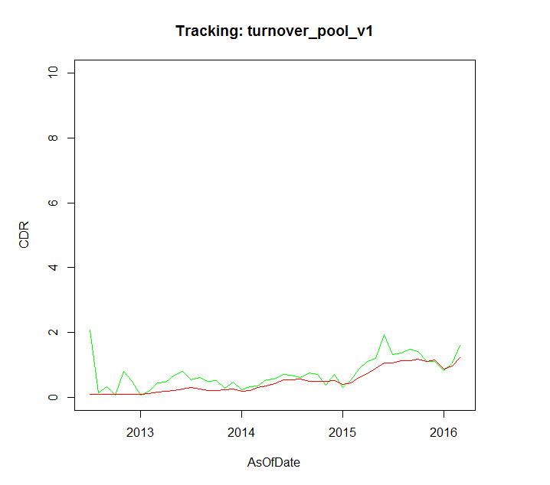
Tracking Performance 2. By Pool Types
Model Tracking Performance
Conventional
Jumbo
Conventional pool tracking shows 2 CPR faster in most recent one year.
Jumbo pools with OTM incentive are quite few.
CQ
CR
CQ pool tracking is more reliable now, as we fixed the incentive calculation for HARPed loans.
Similar as CQs
Actual
Model

Slide 23
Appendix 1. Max Value of Multipliers
 | Min | Max
baselineConstant | 5.823
wala | 0 | 1.570958
hpa | 0.694794 | 1.530962
lockin | 0.474579 | 1.148333
cltv | 0.079905 | 0.987166
seasonality | 0.683492 | 1.241067
Multiplier | 0 | 3.383621
CPR | 0 | 19.71

